Slide 1
Sitting Duck
Cellular Phone Detection for Information Sensitive Settings
December 7th, 2016
Midway Design Review

Slide 2
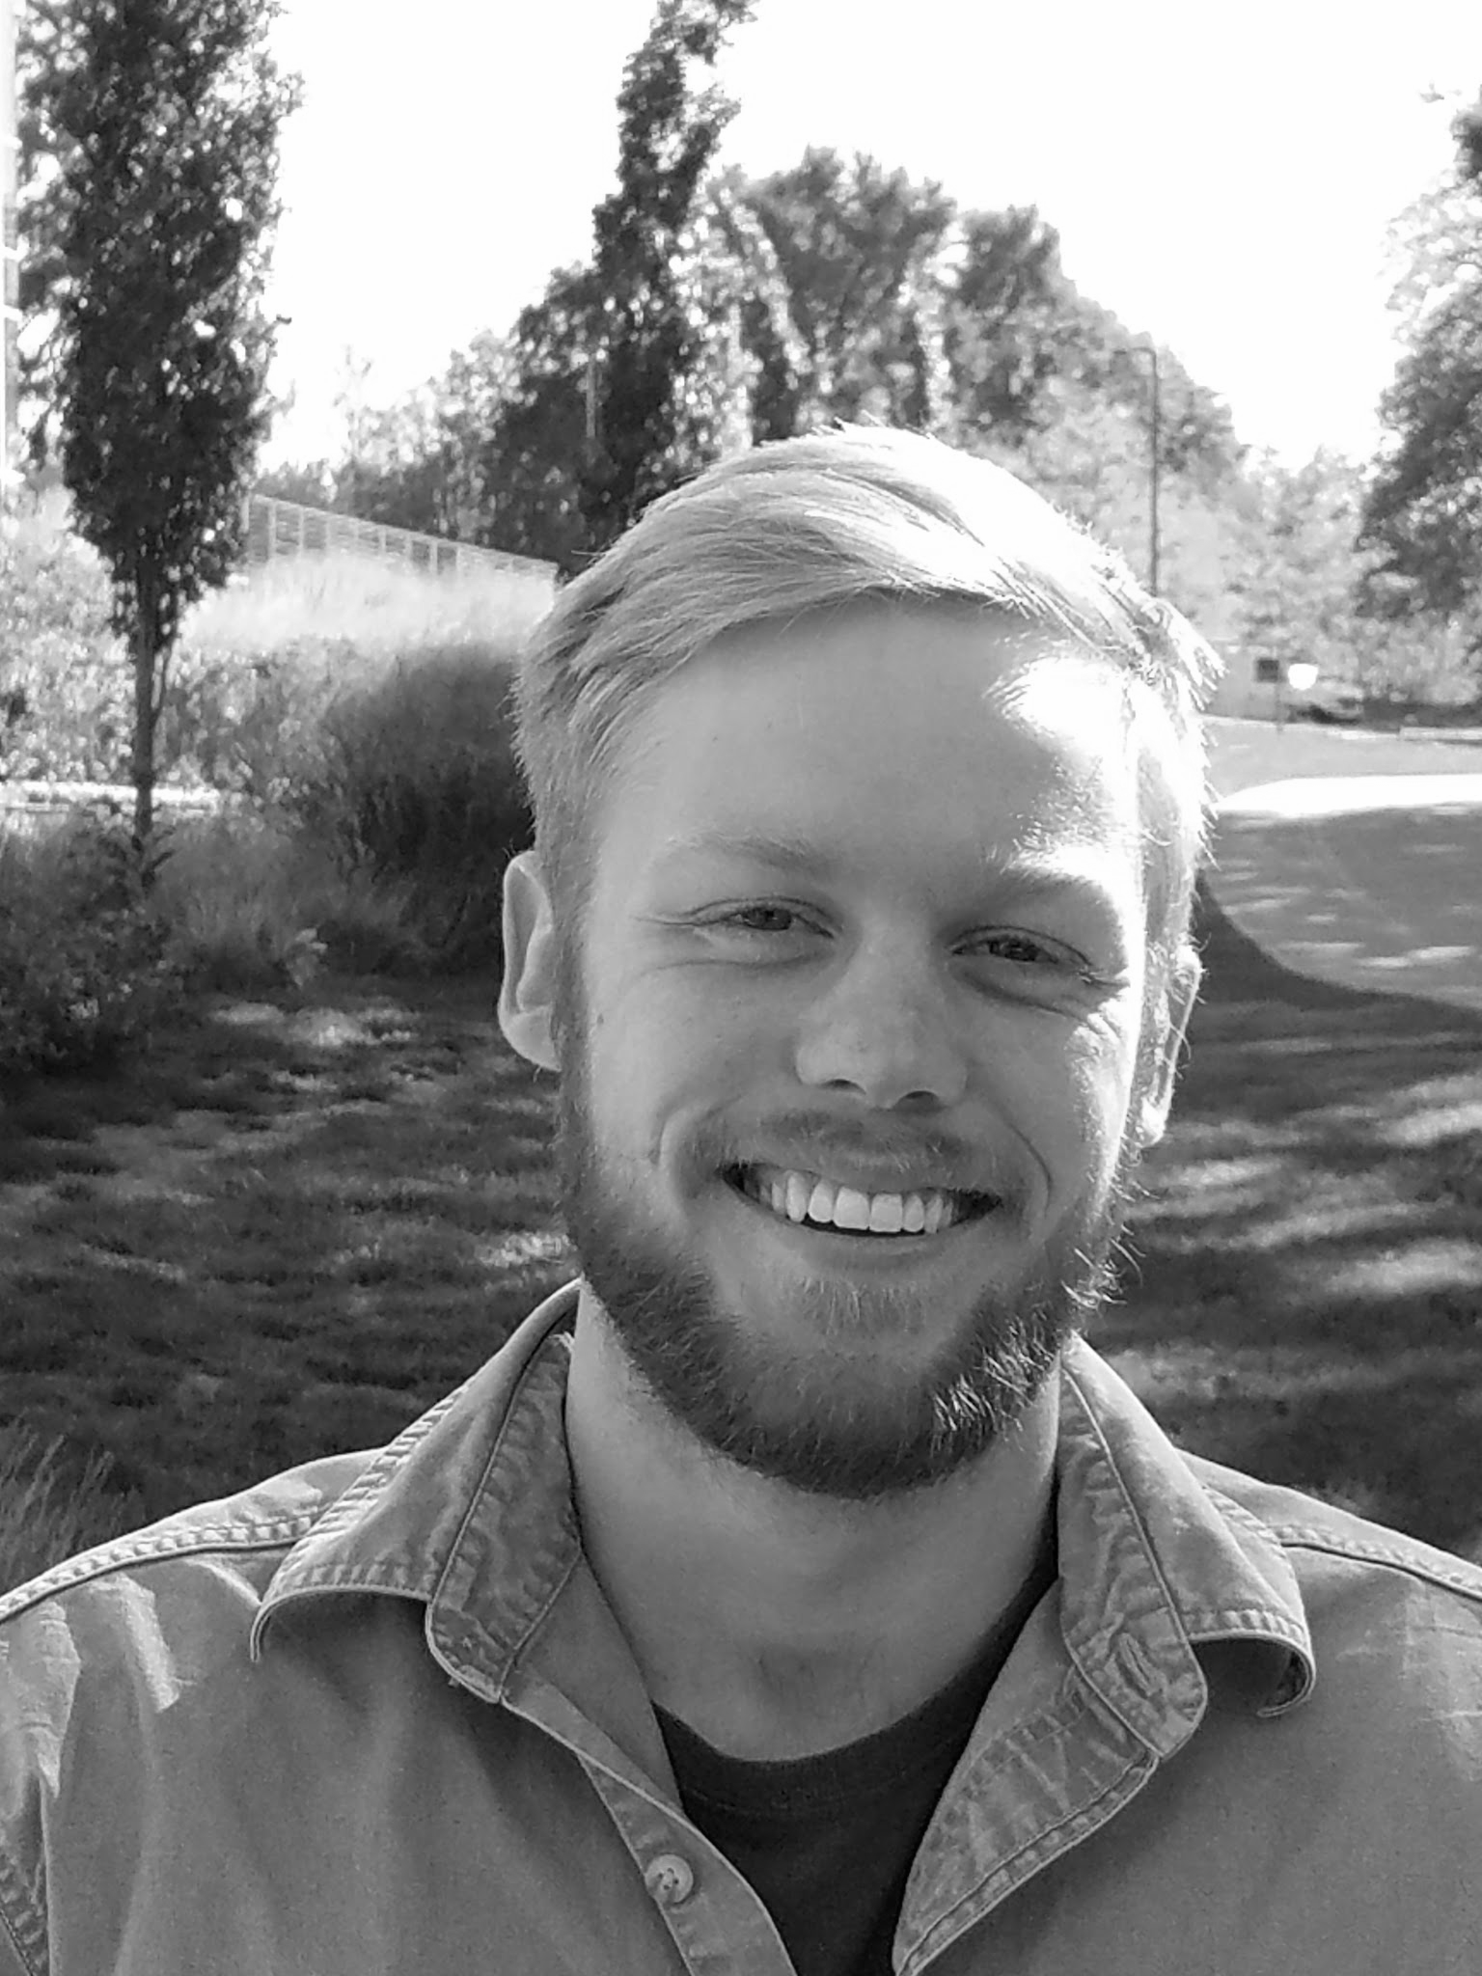
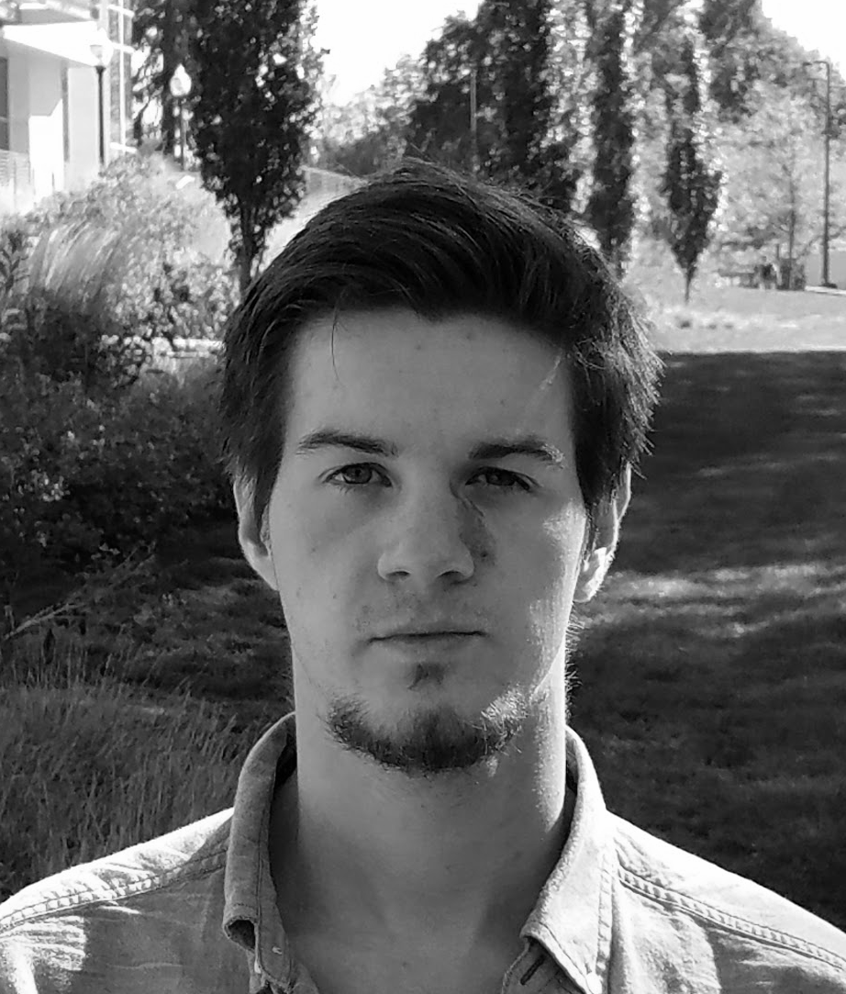
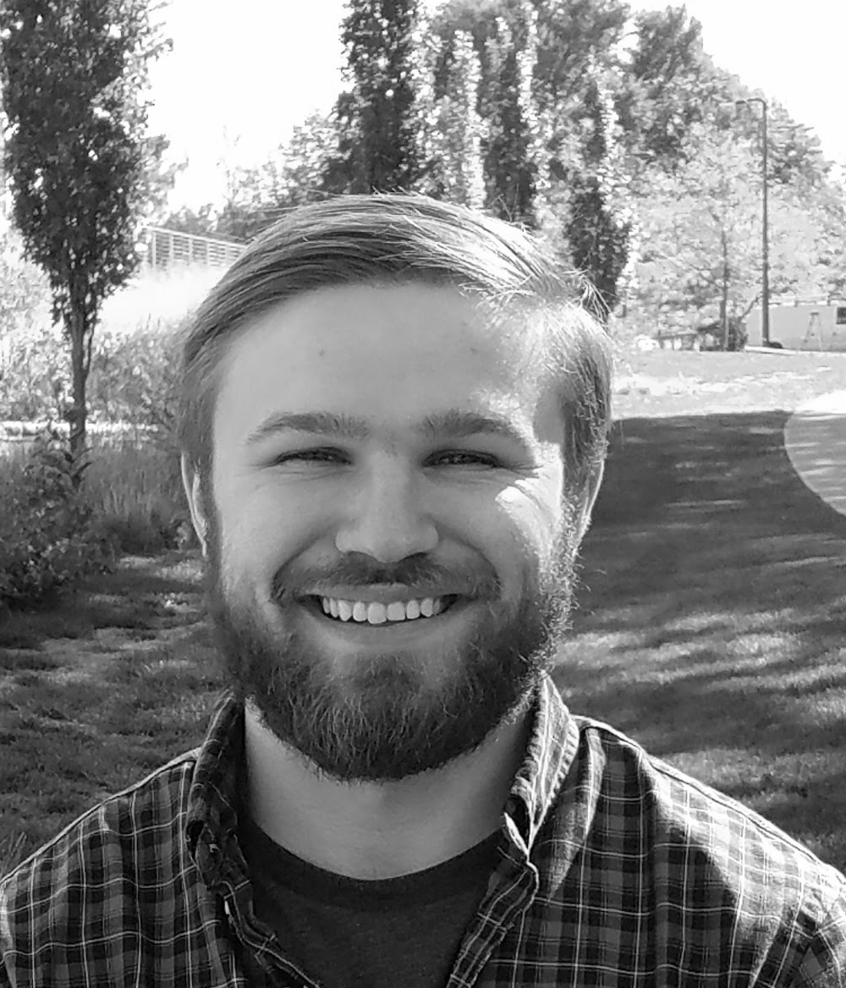
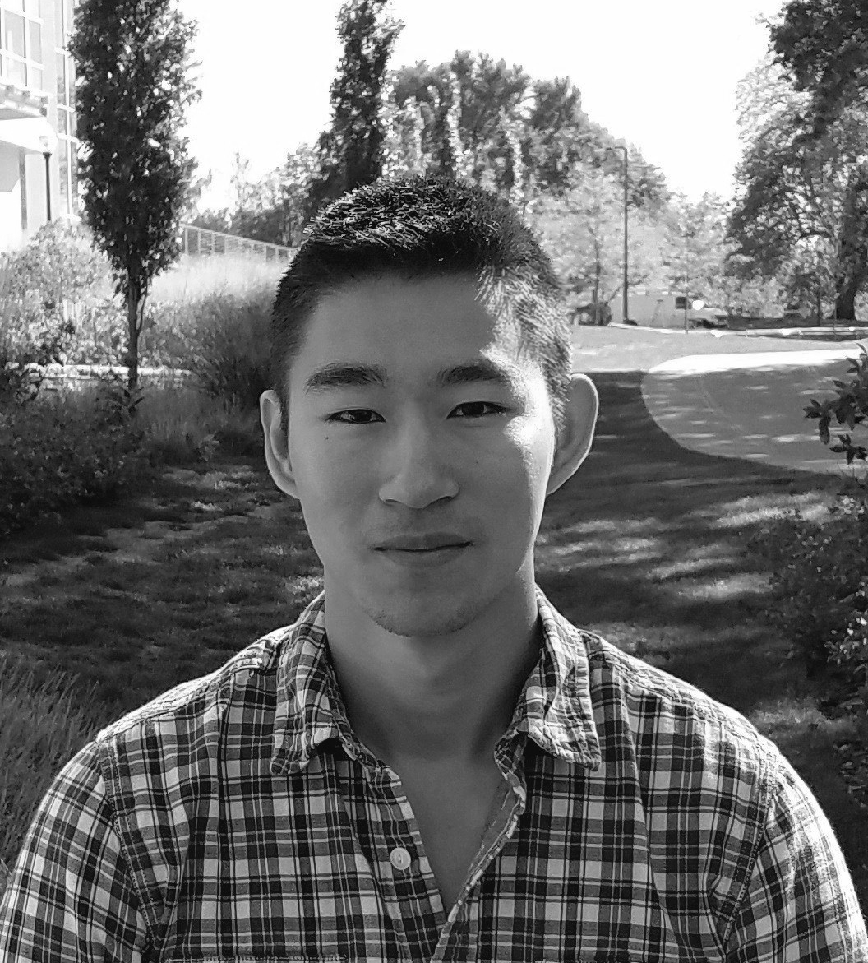
The Team
Sean Turner
EE
Michael Sheehan
EE
Jonathan Jamroga
CSE
Jonathan Yam
CSE

Slide 3
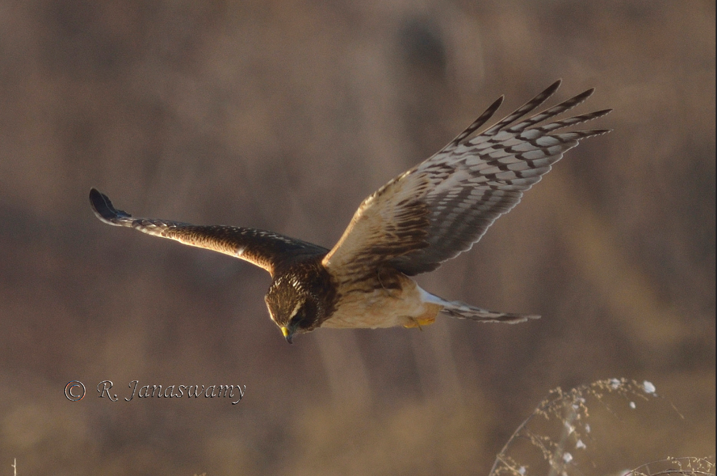
The Advisor
Notes:
Northern Harrier

Slide 4
Mission Objective
Develop a single-room detection system that identifies where and when cell phone use occurs and allow the user to easily visualize and review detection events.
- Physically Non-invasive
- Eliminate manpower and human error
- Selective video evidence
- Ease of use

Slide 5
System Requirements
Accurate
- Localize detection at 40’ range to within ±5°
- <30 second sensor to GUI presentation latency
Easy to Use Presentation
- Real video feed with 2D heat map overlay
- User can playback stored events from times of detections
Operates on commercial cellular phone frequencies
- 850MHz for proof concept
- RF BPF on PCB to filter out undesired frequency bands

Slide 6
Proposed Block Diagram

Slide 7
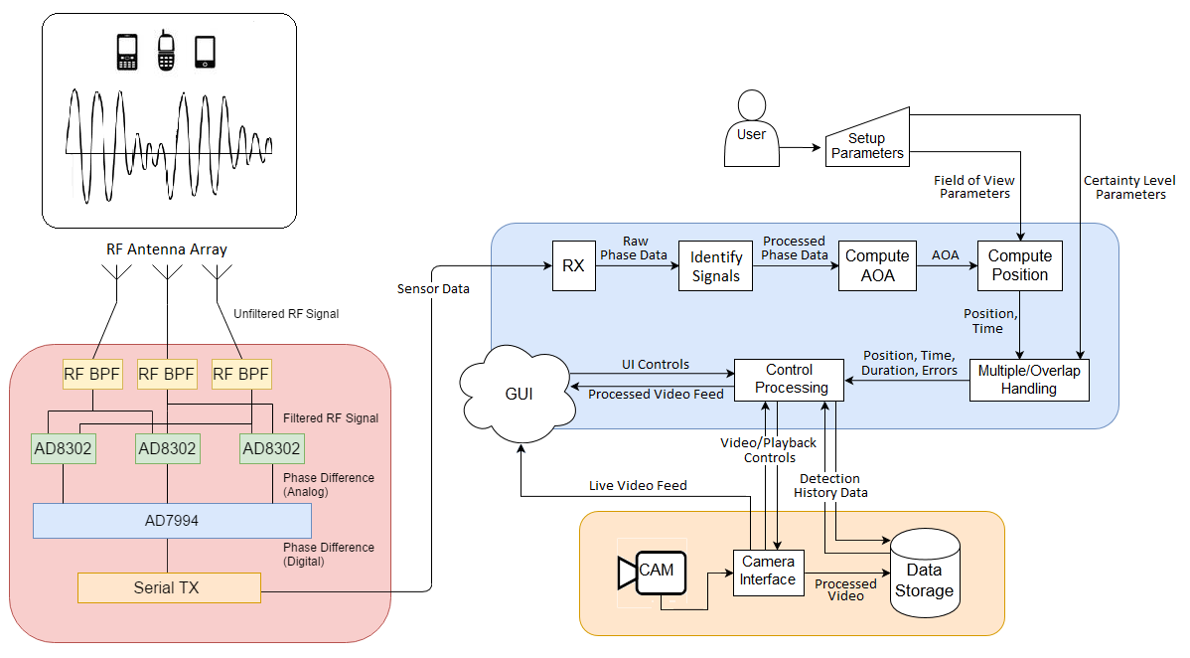
Revised Block Diagram

Slide 8
Chosen Components
RF Phase Detector
  AD8302ARU RF IC (3x)
RF Antenna
  RDA698/2700SSM Dipole Antenna (3x)
RF Power Divider
  PD1020 RF Divider (3x)
A/D Converter
  AD7994 ADC
HD Video Camera
  Logitech C615 HD Webcam

Slide 9
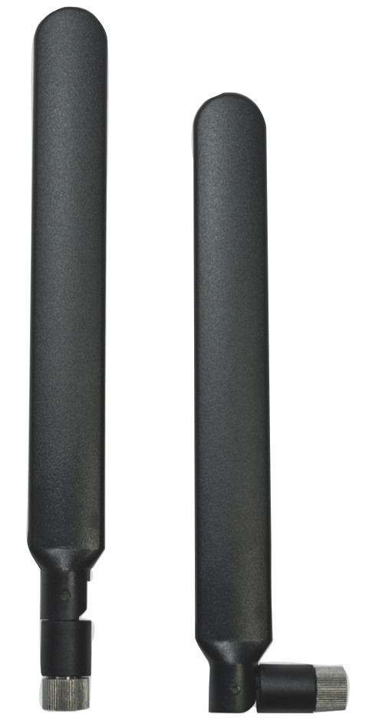
RDA698/2700SSM Dipole Antenna (3x)
Omnidirectional
Frequency Bands:
  698-960MHz
  1710-2170MHz
  2500-2700MHz
3G/4G LTE compliant
Up to 2dBi gain

Slide 10
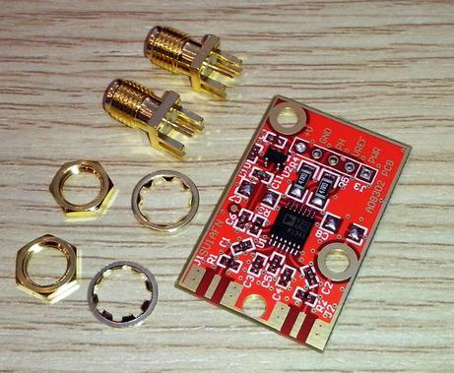
AD8302ARU RF IC (3x)
RF Gain and Phase Detection
RF Capacitors and Precision Resistors
1-2700MHz operating range
60 dB dynamic range

Slide 11
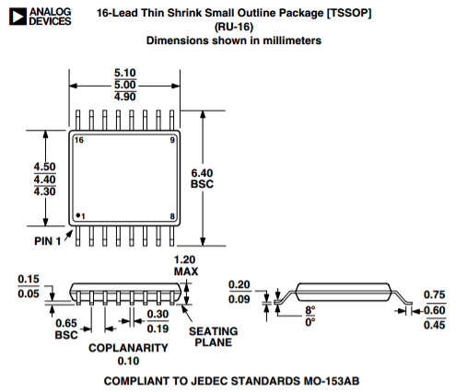
AD7994 ADC
I²C® Compatible Interface
4 Analog Input Channels
12b Resolution
2µs Conversion Time
188k SPS Throughput

Slide 12
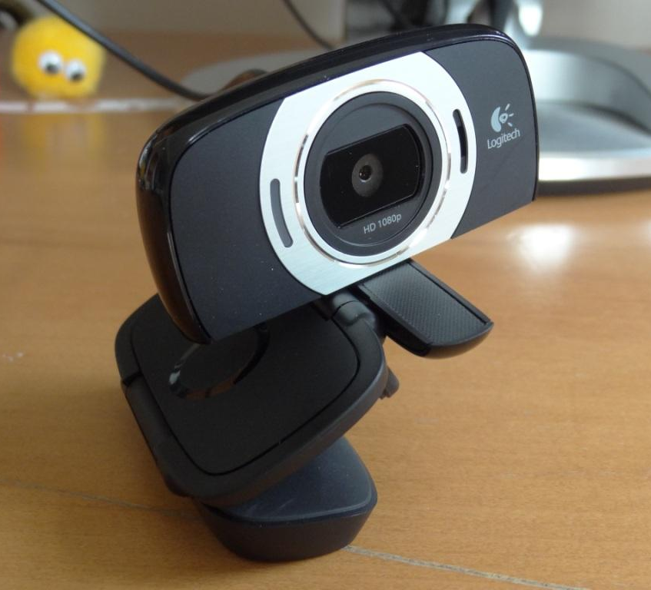
Logitech C615 HD Webcam
Hardware autofocus
Multiple HD resolutions
Natively supported by OpenCV

Slide 13
Proposed MDR Deliverables
RF Bandpass Filter
  Paper design and simulation complete
Power Source
  Paper design and simulation complete
Algorithm Development
  Developed Angle of Arrival and Compute Position algorithms in MATLAB. Tested with simulated sensor inputs.
  Developed data structure for outputs and history.
Camera and GUI
  Camera interfacing and encoding methods analyzed and tested

Slide 14
MDR Accomplishments
RF Bandpass Filter
  Paper design and simulation complete
Power Source
  Paper design and simulation complete
Algorithm Development
  Developed Angle of Arrival and Compute Position algorithms in MATLAB. Tested with simulated sensor inputs.
  Developed data structure for outputs and history.
Camera and GUI
  Camera interfacing and encoding methods analyzed and tested
Interference

Slide 15
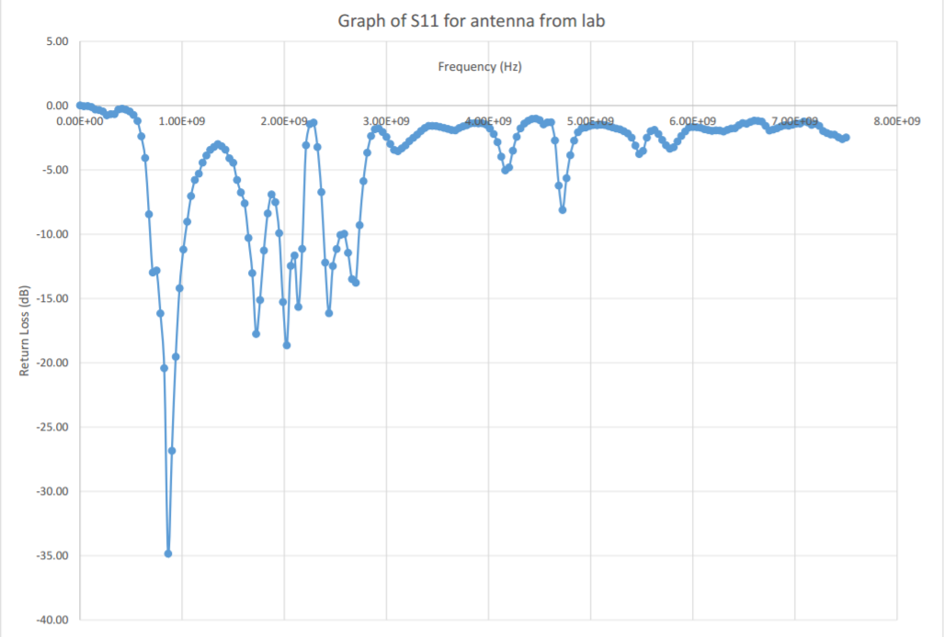
Antenna Frequency Bands

Slide 16
RF BPF
L₁
L₃
C₁
C₃
Z₀ = 50Ω
Z₀ = 50Ω
L₂
C₂
Lumped Element Bandpass: 3rd Order, Maximally Flat

Slide 17
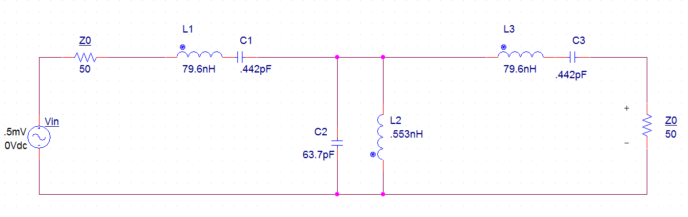
RF BPF Circuit
Z₁
Z₃
Vin’
Vo
Z₂
Lumped Element Bandpass: 3rd Order, Maximally Flat

Slide 18
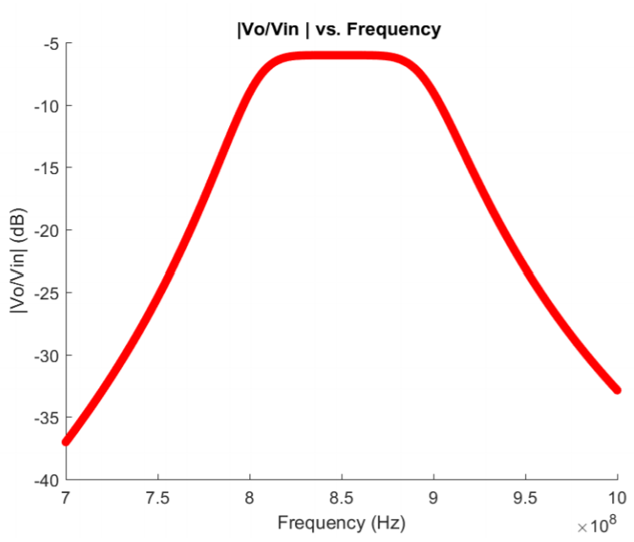
RF BPF Transfer Function

Slide 19
MDR Accomplishments
RF Bandpass Filter
  Paper design and simulation complete
Power Source
  Paper design and simulation complete
Algorithm Development
  Developed Angle of Arrival and Compute Position algorithms in MATLAB. Tested with simulated sensor inputs.
  Developed data structure for outputs and history.
Camera and GUI
  Camera interfacing and encoding methods analyzed and tested
Interference

Slide 20
Power System Specifications
Powering the Sensor Subsystem:
AD8302ARU RF IC
  12V at 20mA
  (3 Required)
AD7994 ADC
  5V at 20mA

Slide 21
Power System Circuit Diagram

Slide 22
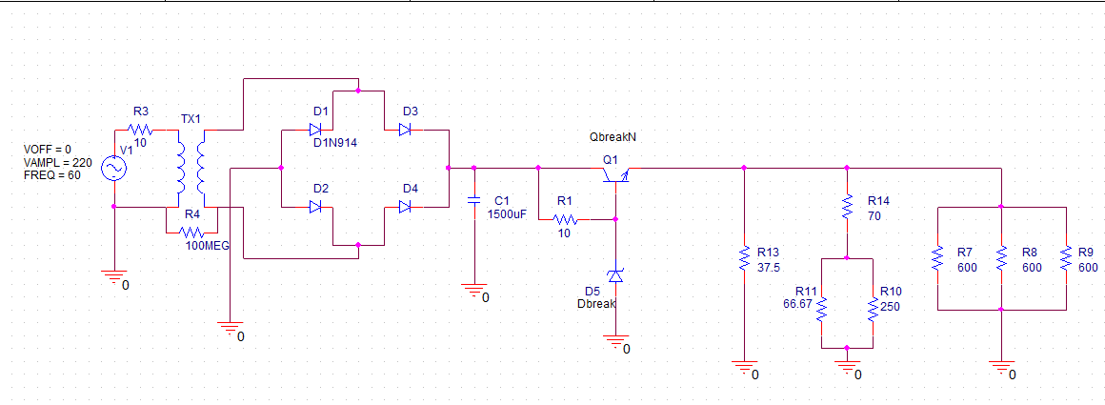
Power System Simulated Circuit
Voltage Regulator
AD7994
AD8302ARU

Slide 23
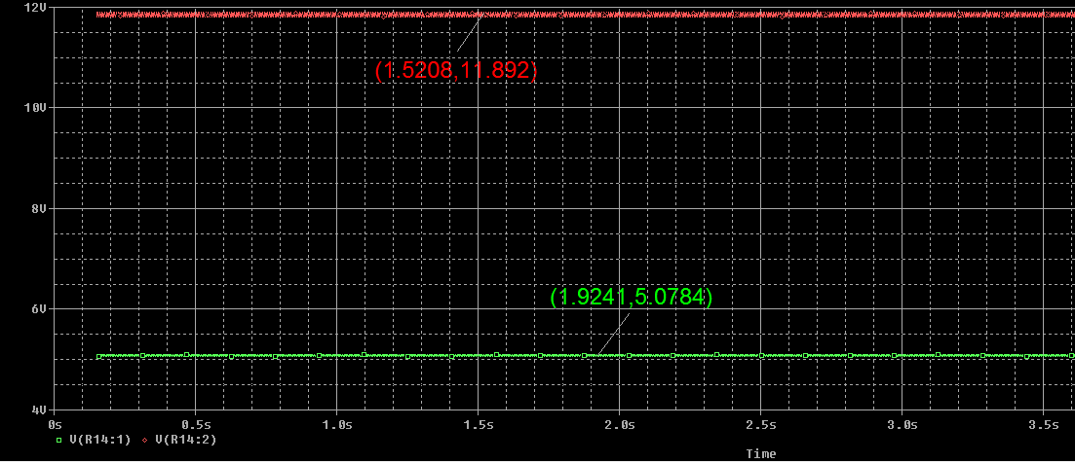
Power System Simulated Results

Slide 24
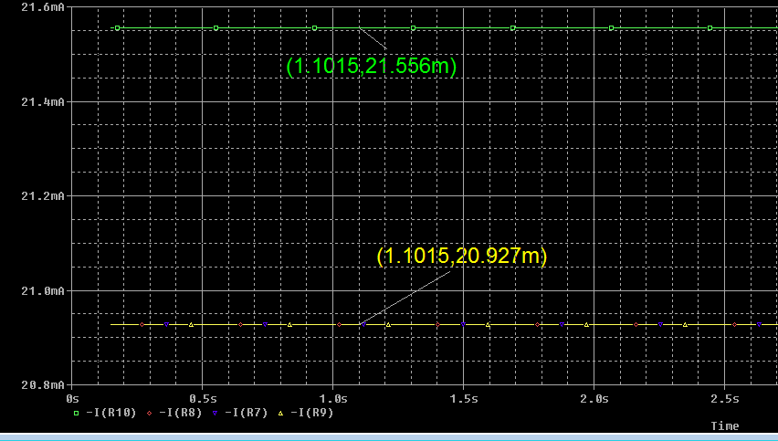
Power System Simulated Results

Slide 25
MDR Accomplishments
RF Bandpass Filter
  Paper design and simulation complete
Power Source
  Paper design and simulation complete
Algorithm Development
  Developed Angle of Arrival and Compute Position algorithms in MATLAB. Tested with simulated sensor inputs.
  Developed data structure for outputs and history.
Camera and GUI
  Camera interfacing and encoding methods analyzed and tested
Interference

Slide 26
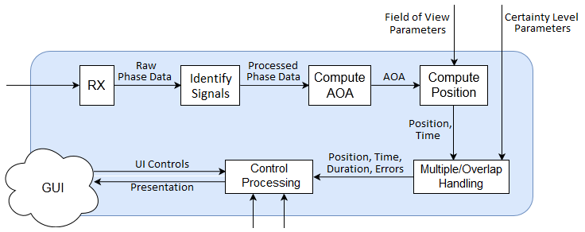
Processing Subsystem Requirements
Data quantized, sampled, processed, stored efficiently
Adjustable to user preference by user input
  Field of View, Detection Range, Detection Sensitivity
Angle of Arrival ±5° at 40’ range
Position ±6’ at 40’ range

Slide 27
Algorithms: Calculations Overview
[Phases] → [Angles of Arrival]
  Using properties of waveforms, phase difference, antenna separation
  AOA ambiguity introduced from the sensor subsystem
[Angles of Arrival] → [Azimuths / Intersections]
  2D, Trigonometry
  AOA ambiguity produces erroneous azimuths
[Azimuths / Intersections] → [Ambiguous Positions]
  2D, Trigonometry
  Erroneous azimuths produce erroneous positions
[Ambiguous Positions] → [Approximated Position]
  Pre-Processing, Exclusion Criteria, Approximation Criteria, Clustering

Slide 28
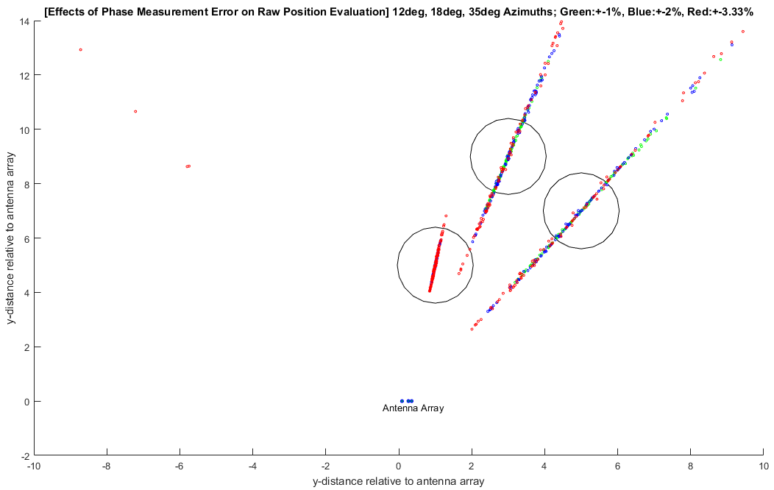
Algorithms: MATLAB Model
Demonstration
Test Models
Error Models

Slide 29
Algorithms: Sampling & Computing Phases
Constant sampling, batch processing
Fills sampling buffer with raw data from the RX interface
  Receive ADC-quantized voltage levels from the sensor subsystem
  Compute the phase value associated with each voltage
Each batch of phase samples and time data is passed forward in an array

Slide 30
Algorithms: Signal Identification
Identifies if the phase data represents a transmission of user’s interest
  Dependent on adjustable user input at setup
  Eliminate non-stationary transmissions and sporadic signals
Process flow proceeds only if the phase data from the batch…
  is consistent in phase value (Majority Element/Voting)
  is persistent over time (Minimum Duration Threshold)

Slide 31
Algorithms: Computing Angle of Arrival
Determines the transmission angles incident to the antenna arrays
  Each phase corresponds to a sign-ambiguous angle
  Requires known wavelength (fixed specific to sensor subsystem)
  Requires known antenna setup (fixed specific to sensor subsystem)
Each batch of AOA samples and time data is passed forward in an array

Slide 32
Algorithms: Computing Position
Approximates 2D location of each sample in the batch
Computes all possible two-azimuth intersections from each sample
Determines the most-likely of the positions
  Clustering (Voting/Squared-Euclidean Distance Comparison)
  Field of View Exclusion (Point Comparison)

Slide 33
MDR Accomplishments
RF Bandpass Filter
  Paper design and simulation complete
Power Source
  Paper design and simulation complete
Algorithm Development
  Developed Angle of Arrival and Compute Position algorithms in MATLAB. Tested with simulated sensor inputs.
  Developed data structure for outputs and history.
Camera and GUI
  Camera interfacing and encoding methods analyzed and tested
Interference

Slide 34


Video: Libraries
OpenCV
Computer Vision Library: Python and C++
Supports live feed, recording, encoding, and video processing
Kivy
GUI Library: Python
Cross platform development
Supports video playback

Slide 35
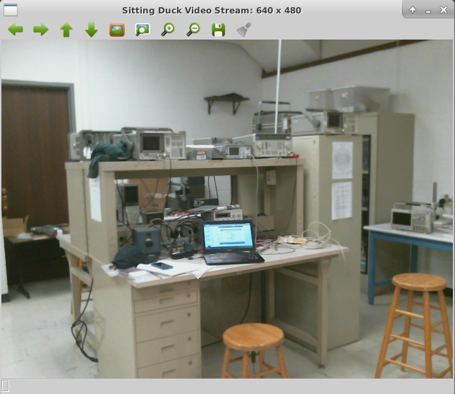
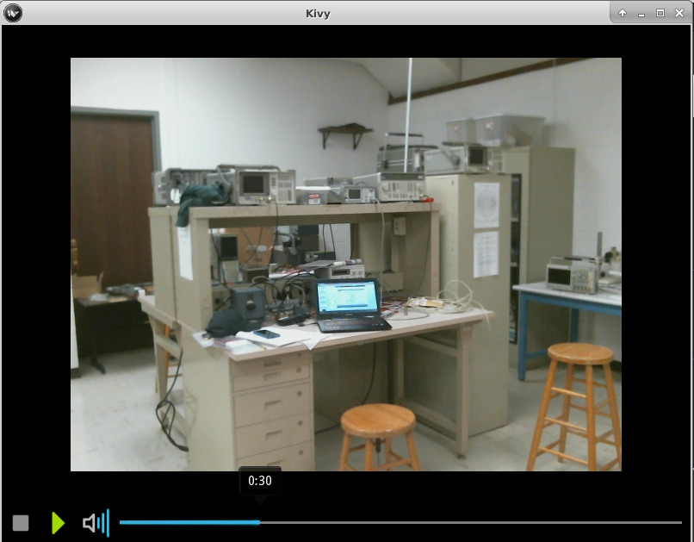
Video Stream and Playback

Slide 36
Sample Size | 15s |  | 30s |  | 45s |  | 60s
FOURCC Code | (MB) Video Size | (GB) 2HR Estimate | (MB) Video Size | (GB) 2HR Estimate | (MB) Video Size | (GB) 2HR Estimate | (MB) Video Size | (GB) 2HR Estimate
MJPG | 12.6 | 5.92 | 13.8 | 3.23 | 48.4 | 7.56 | 67.5 | 7.91
XVID | 2.6 | 1.23 | 4.4 | 1.03 | 7.4 | 1.15 | 11.4 | 1.33
H264 | 3.3 | 1.53 | 6.5 | 1.52 | 9.6 | 1.51 | 12.7 | 1.49
FMP4 | 1.9 | 0.91 | 5.7 | 1.33 | 8.1 | 1.26 | 9.5 | 1.12
X264 | 3.4 | 1.58 | 6.4 | 1.51 | 9.5 | 1.48 | 13.1 | 1.53
H263 | 1.0 | 0.48 | 1.7 | 0.39 | 2.4 | 0.37 | 2.9 | 0.33
VP80 | 0.23 | 0.11 | 0.43 | 0.11 | 0.53 | 0.083 | 0.82 | 0.09

Slide 37
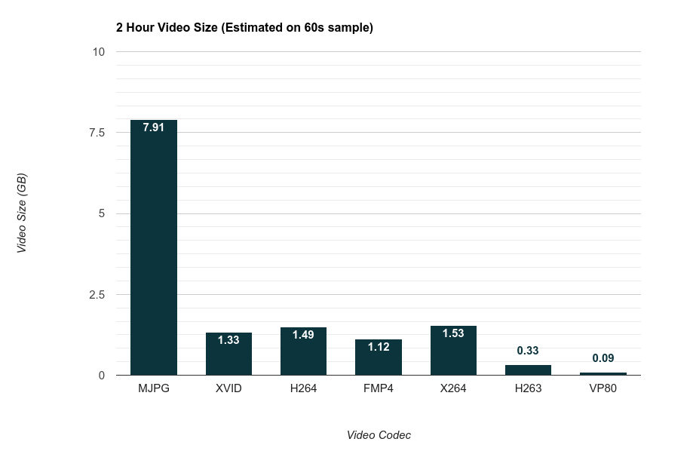

Slide 38
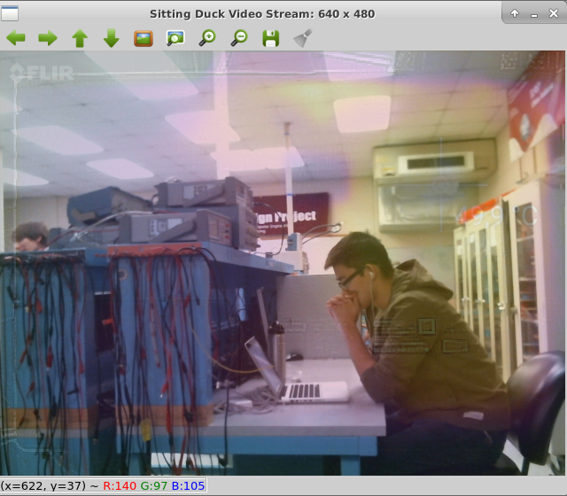

Video Mixing: Alpha Blending
Low overhead computation
  Weighted Sum
Supported by OpenCV library
Overlay in video stream
  Saved to file in real time

Slide 39
MDR Accomplishments
RF Bandpass Filter
  Paper design and simulation complete
Power Source
  Paper design and simulation complete
Algorithm Development
  Developed Angle of Arrival and Compute Position algorithms in MATLAB. Tested with simulated sensor inputs.
  Developed data structure for outputs and history.
Camera and GUI
  Camera interfacing and encoding methods analyzed and tested
Interference

Slide 40
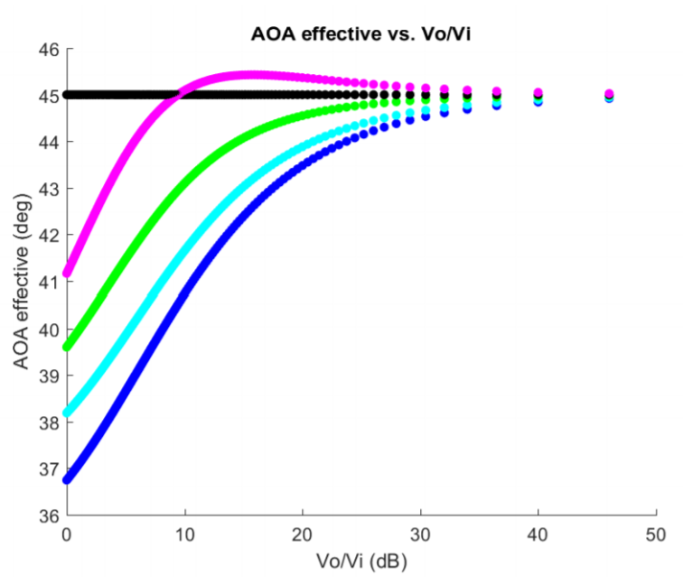
Effect of Interference

Slide 41
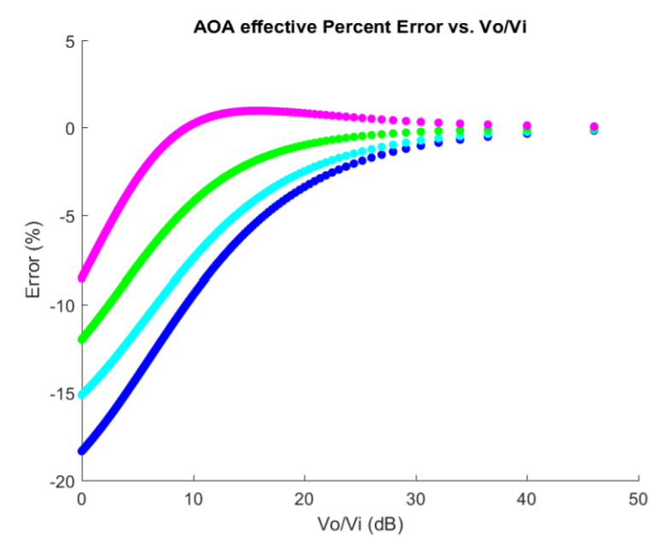
Effect of Interference

Slide 42
Proposed CDR Deliverables
RF BPF fabricated
Power Board fabricated
Preliminary UI integrated
Demonstrate Complete System Functionality
  Subsystems integrated
Testing
  Test Sensor Subsystem with live data
  Test Processing Subsystem with live data

Slide 43
Responsibilities - Michael Sheehan
RF BPF fabricated
Power Board fabricated
Preliminary UI integrated
Demonstrate Complete System Functionality
  Subsystems integrated
Testing
  Test Sensor Subsystem with live data
  Test Processing Subsystem with live data

Slide 44
Responsibilities - Sean Turner
RF BPF fabricated
Power Board fabricated
Preliminary UI integrated
Demonstrate Complete System Functionality
  Subsystems integrated
Testing
  Test Sensor Subsystem with live data
  Test Processing Subsystem with live data

Slide 45
Responsibilities - Jonathan Yam
RF BPF fabricated
Power Board fabricated
Preliminary UI integrated
Demonstrate Complete System Functionality
  Subsystems integrated
Testing
  Test Sensor Subsystem with live data
  Test Processing Subsystem with live data

Slide 46
Responsibilities - Jonathan Jamroga
RF BPF fabricated
Power Board fabricated
Preliminary UI integrated
Demonstrate Complete System Functionality
  Subsystems integrated
Testing
  Test Sensor Subsystem with live data
  Test Processing Subsystem with live data

Slide 47
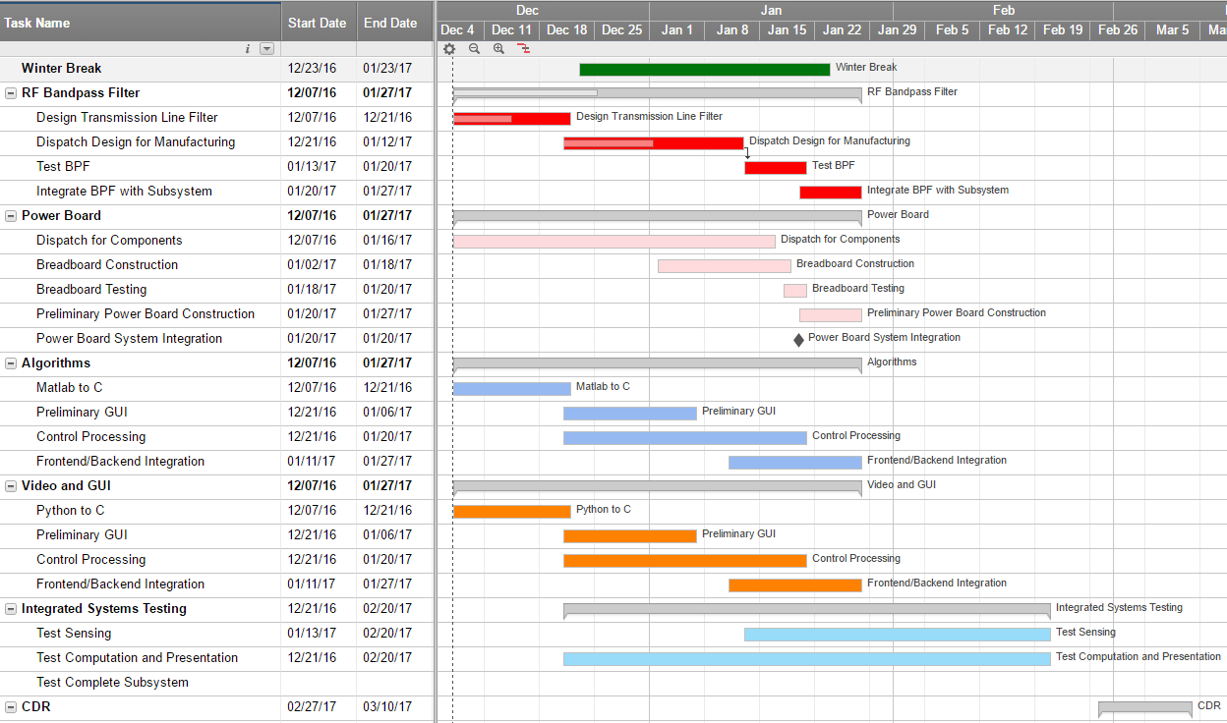

Slide 48
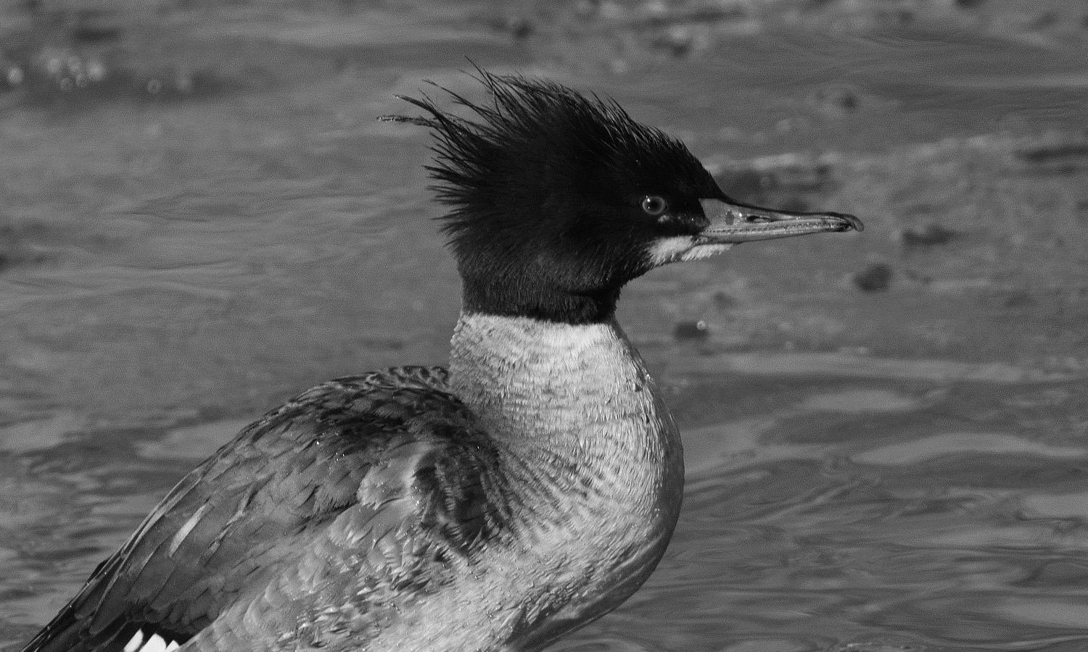
Questions?

